Slide 1
COVID-19 Dashboard
Gummadi Sai Dheeraj

Slide 2
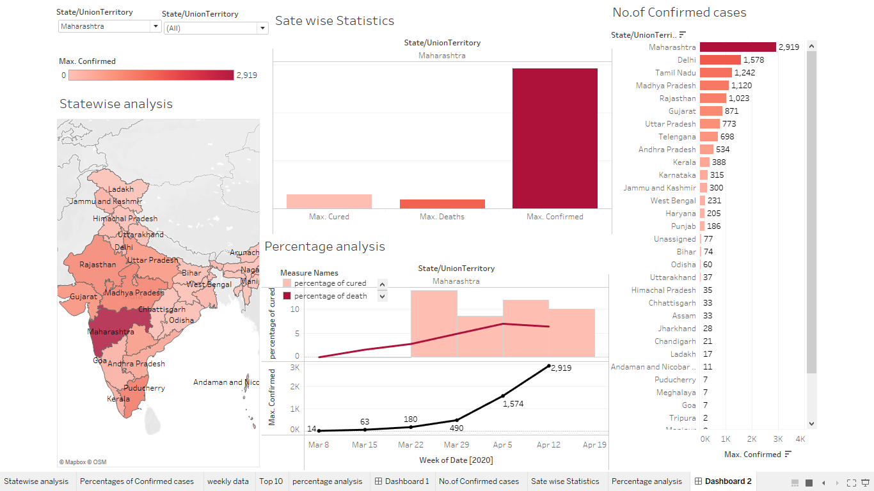
Overview

Slide 3
Data set
I have downloaded data set from kaggle.
I have analyzed Covid 19 spread in India using the data set with the help of Dashboard.
The reason I have chosen this topic is because, I have been working on COVID-19 detection for a while and published one research paper on “COVID-19 detection”
Video: https://drive.google.com/file/d/1ilJ6yIjHvAdj1EGVeMg-YGW5TnLXC0_J/view?usp=sharing

Slide 4
Thank You.

